Slide 1
Edeth
Computer Assistant

Slide 2

Mini Project
on
Computer Assistant
BY
KARAN PANDEY
1901320310042
Under the guidance
of
Mr. Shiv Sir

Slide 3
OBJECTIVE

Slide 4
Computer Assistant
Computer Assistant are use to assist Computer users with technical issues through problem-solving.
It helps Computer users in better interface for working on the computer.
It also reduce the work efforts of the user on the computer .
Some examples of Computer Assistant now a days are :-
Cortana (Windows assistant)
Siri (IOS assistant)

Slide 5
METHADOLOGY

Slide 6
About EDETH and its UNIQUENESS
As I describe Computer Assistant before , it is to assist user in technical work.
As for my knowledge all the popular computer assistant available in the market do use internet to perform even their single task, and we can see each and everything we see nowadays are connected with internet.
This makes me feel to develop an assistant which can work with internet wisely and don’t have any issues to download offline packages.
This make EDETH a unique assistant.
Although it can not work as a proper assistant but I am working on it to add as many features as I can to make EDETH a good assistant.

Slide 7
DESIGN and RESULT

Slide 8
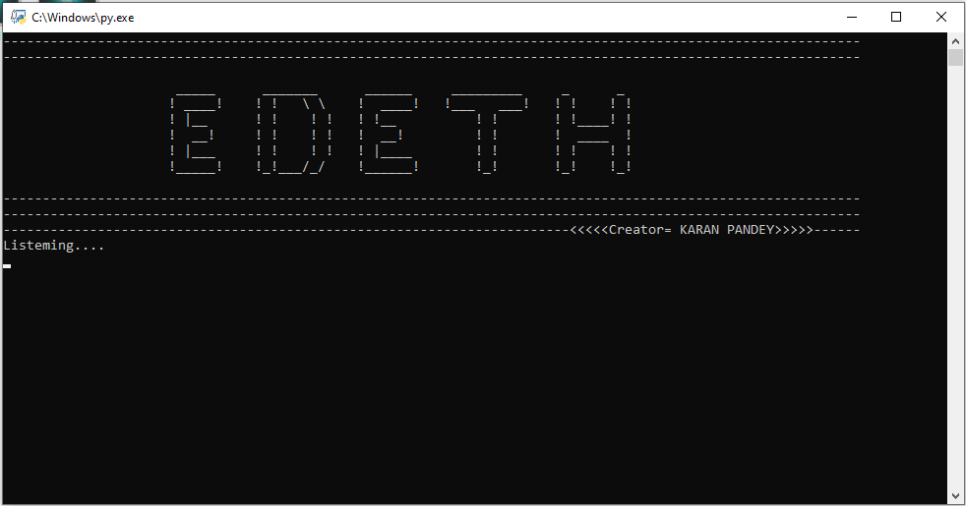
First Look

Slide 9
Language Used
PYTHON
Python is an interpreted, object- orientated and a high level programming language.
It is a general purpose programming language that is often applied in scripting role.
Why I use python for creating my project :-
Easy to understand & Easy to learn.
Simple to use.
Rich libraries.
Fewer code lines , less time.
It has a big community.

Slide 10
Python libraries used
Pyttsx3
Text to speech library.
Speech Recognition
Speech to text library.
OS
Provide interface to program
with the operating system.
Wikipedia
Wikipedia module.
Webbrowser
It provide interface to search
anything using default browser
Datetime, time, google search ,
Etc. as for the requirement.

Slide 11
What can this Assistant do for you?
EDETH works as ONLINE ASSISTANT
It can open Websites.
It can open applications (like MS Word ,VS Code ,Spotify etc) .
It can search on Wikipedia.
It can save reminders .
It can provide as current time.

Slide 12
CONCLUSION

Slide 13
Is EDETH an A.I.?
A lot of people will argue that the virtual assistant that I have created is not an A.I. , but it is the output of the bunch of the statements. But , if we look at the very basic level , the sole purpose of an A.I. Is to develop machines that can perform human tasks with the same effectiveness or even more effectively than humans.
It is a fact that this virtual assistant is not a very good example of A.I. , but it can be an A.I. if I work in it more and more with the help of machine learning ,neural networks, Cognitive computing,etc

Slide 14
Advantages of EDETH
This work on the voice commands.
It will neglect the time taken by the user to open a application (which he/she use frequently).
Somehow this provides a different interface between the User and his/her Personal Computer.
User can search the web , wikipedia.

Slide 15
Disadvantages
For now this will only work on Windows Operating System.
If more than one commands are given at the same time it will only perform the command whose source code is written at first.
You have to say the hotword every time to activate EDETH

Slide 16
FUTURE SCOPE

Slide 17
Currently, there are several different companies developing virtual assistant technology, each targeting their own devices and hardware. For example, Microsoft’s Cortana works best with Windows 10 devices, Amazon’s Alexa works best with Amazon Devices, and Google Home uses its own platform.
More over in future these are going to be a part of our daily life.
So, the future scope of my virtual assistant “EDETH” will be bright by the requirement it fulfil for the user who will be using it.
It has to be more user friendly and perform more task in future. And I would love to make this assistant to capable in all the electronic devices in future.

Slide 18
References
While working on EDETH I had a big help from “ Youtube “ for where to start with.
“ Internshala “ was the platform from where I had learn python language and had a good command on it.
As I said before python has a big community , so I even have many help from them by websites “ Github , Stackoverflow etc “ .

Slide 19
THANK YOU

